Slide 1

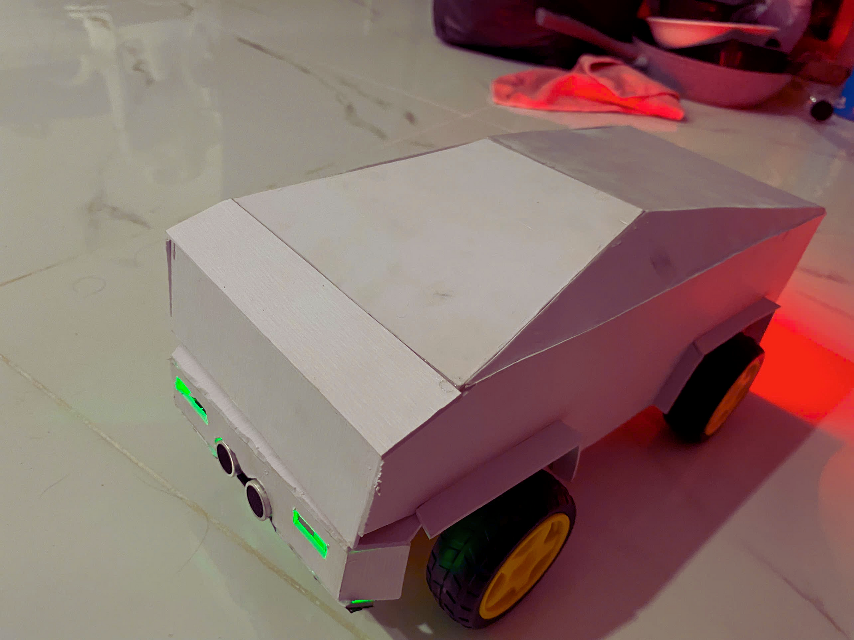
BLUETOOTH CONTROLLED ROBOT CAR
GROUP 4 - IOT102t

Slide 2







THE TEAM
ĐOÀN LÝ HỒNG MINH
SE180733
Leader,code,assembling components
NGUYỄN VĂN BẮC
PHAN QUỐC LÂM
SE180739
SE182754
Writing report,circuit diagram
Video demo,prepare hardware
HỒ ĐĂNG QUANG
TRẦN VĂN QUYẾT
SE180734
SE181574
Design block diagram,flowchart
Powerpoint,prepare presentation

Slide 3
Agenda
Overview Of Project Features 01
02 Block Diagram Overview
Functional analysis of components 03
04 Circuit details
Device images and functionality 05
06 Control App Introduction and Demo project
Practical applications and future plans 07
08 Conclusion

Slide 4

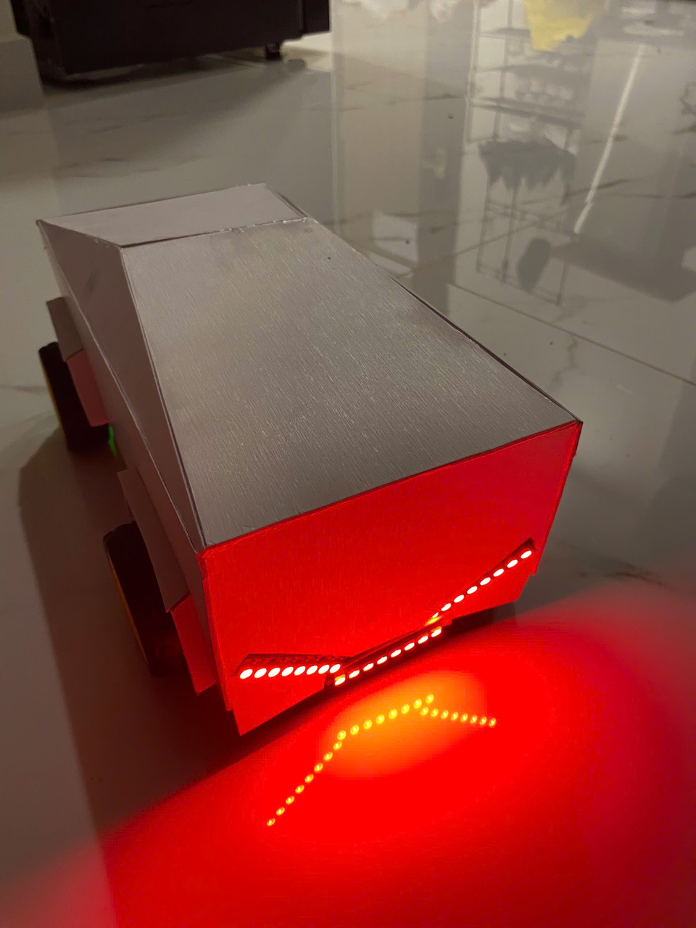

OVERVIEW OF Project Features
The Arduino Car project uses Bluetooth control, IR and ultrasonic sensors for safe and flexible movement. It can move forward, backward, and turn, with WS2812B LEDs for turn signals and reverse lights. IR sensors detect obstacles, triggering reverse and stop actions, while ultrasonic sensors warn of nearby obstacles with sound and light. The system uses DC motors, the L298N motor driver, and the FastLED library for intelligent movement. The project aims to create a functional, intelligent car with potential economic benefits.

Slide 5

Electric components
HC-SRF05
LED RED
2 IR Sensor HW-201
HC-05 Bluetooth Module
Piezo Buzzer
6. DC Motor 1 2 3 4
7. Arduino UNO
8. Led RGB WS2812B
9. L298N Motor Driver

Slide 6
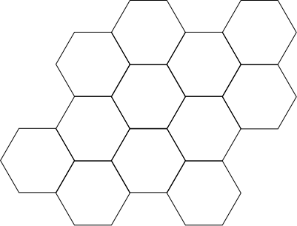
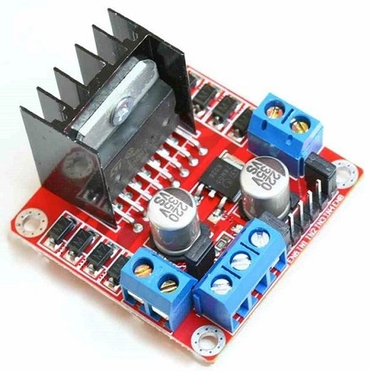

L298N Motor Driver

Slide 7

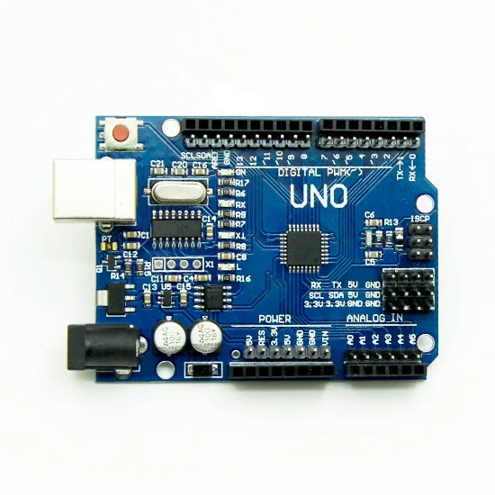
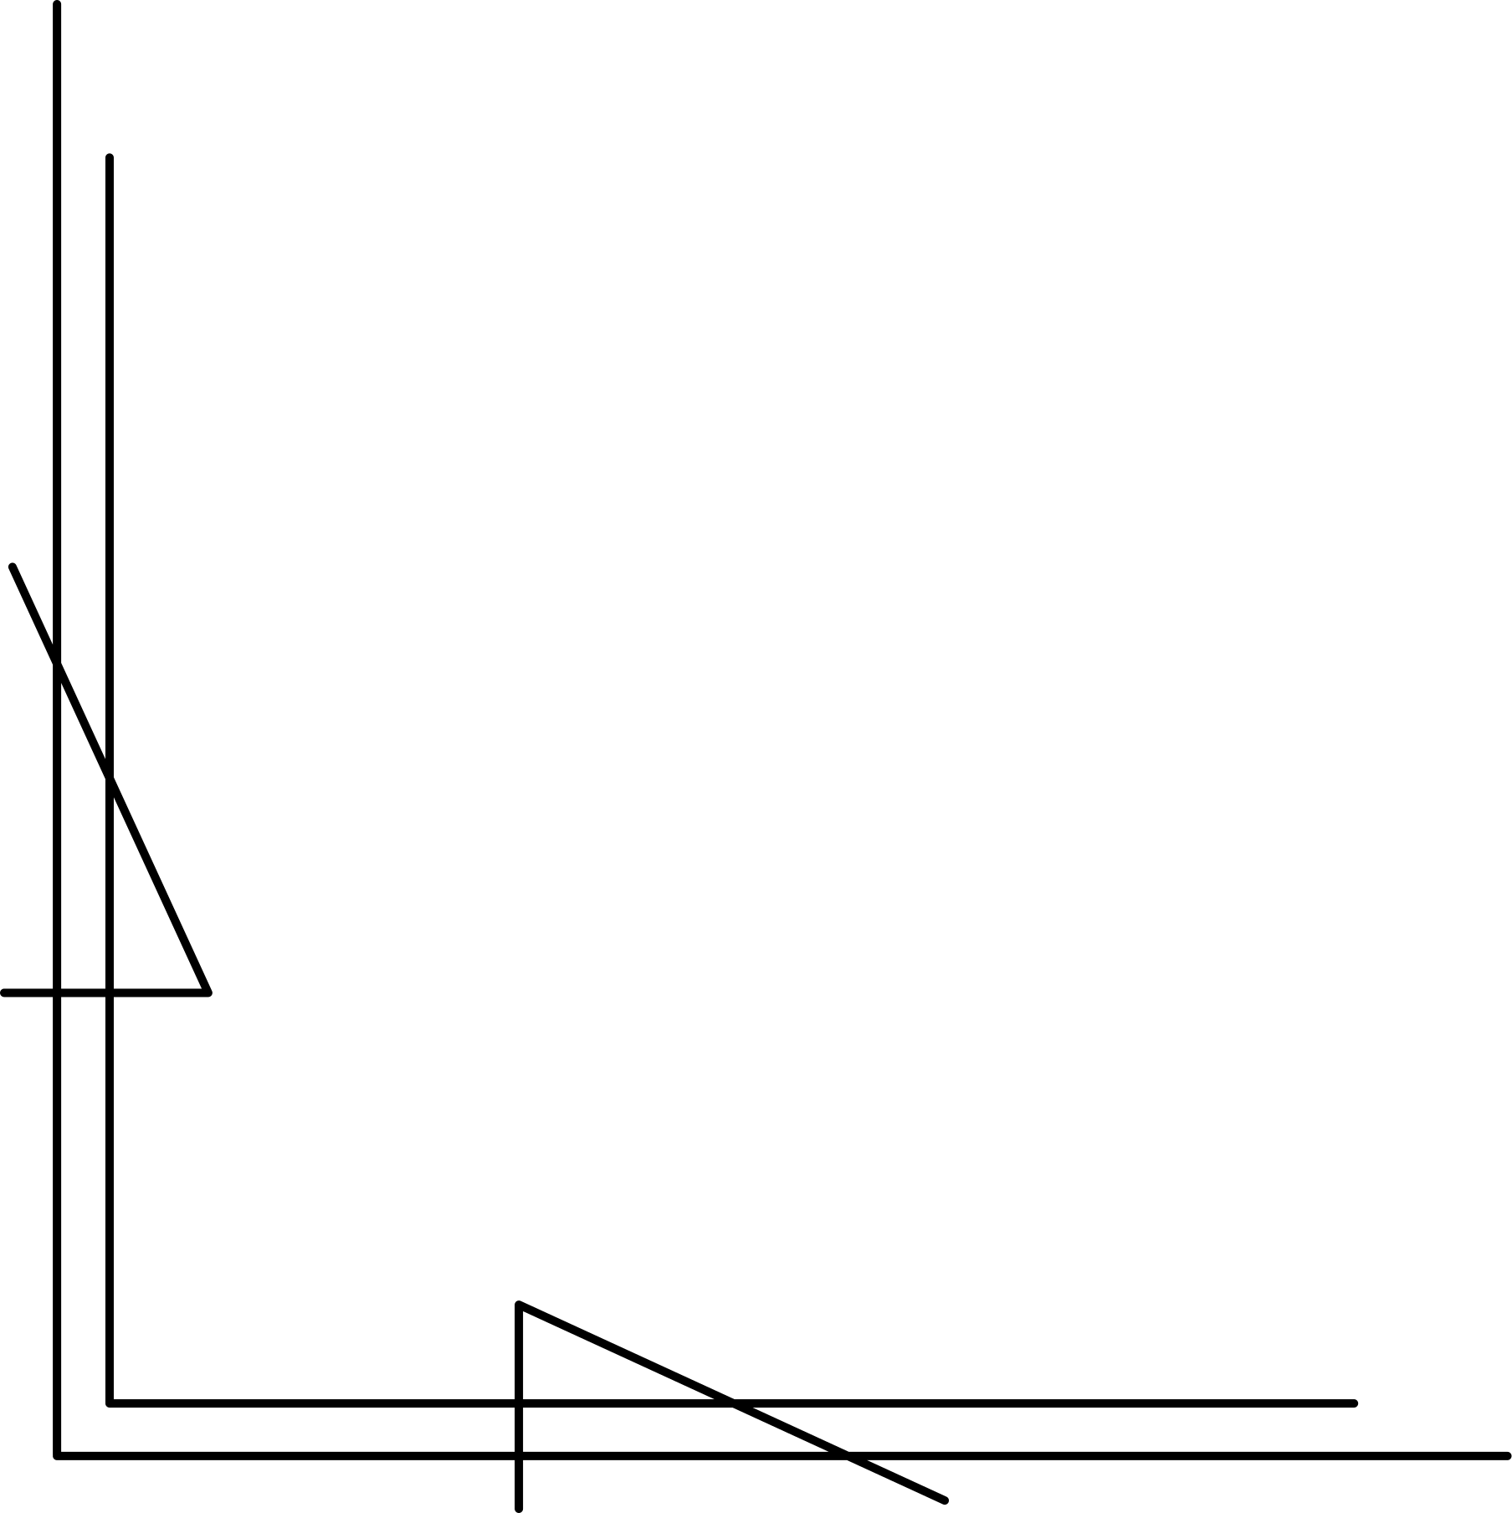
Arduino UNO

Slide 8
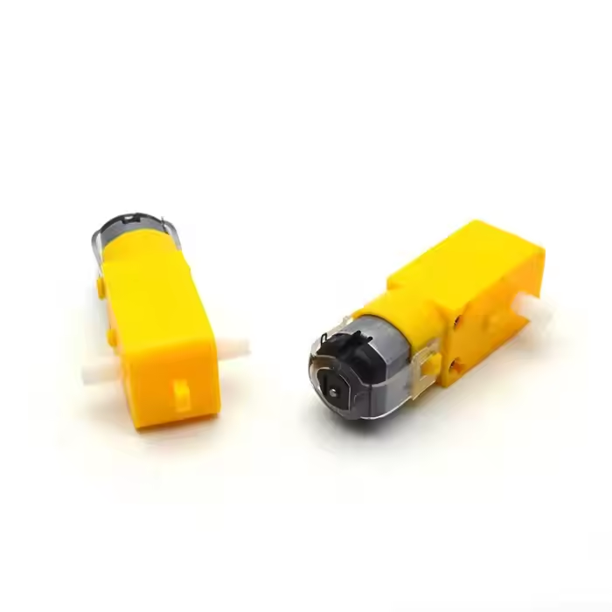
DC Motor

Slide 9
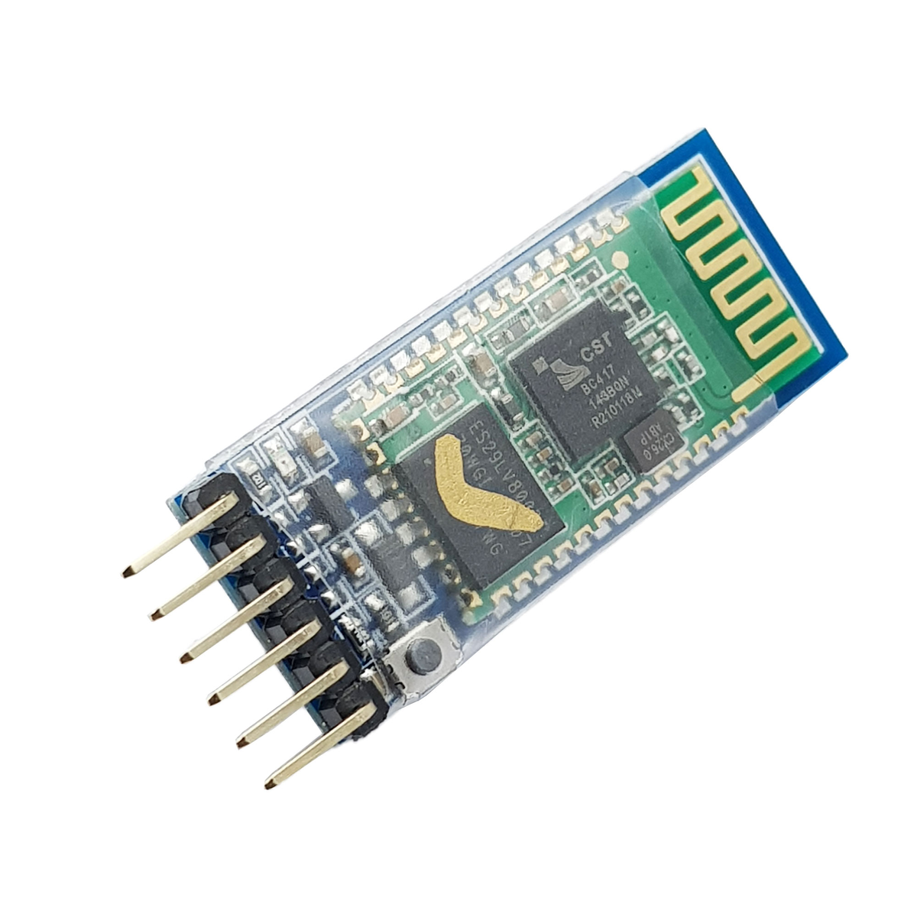

HC-05 Bluetooth Module

Slide 10
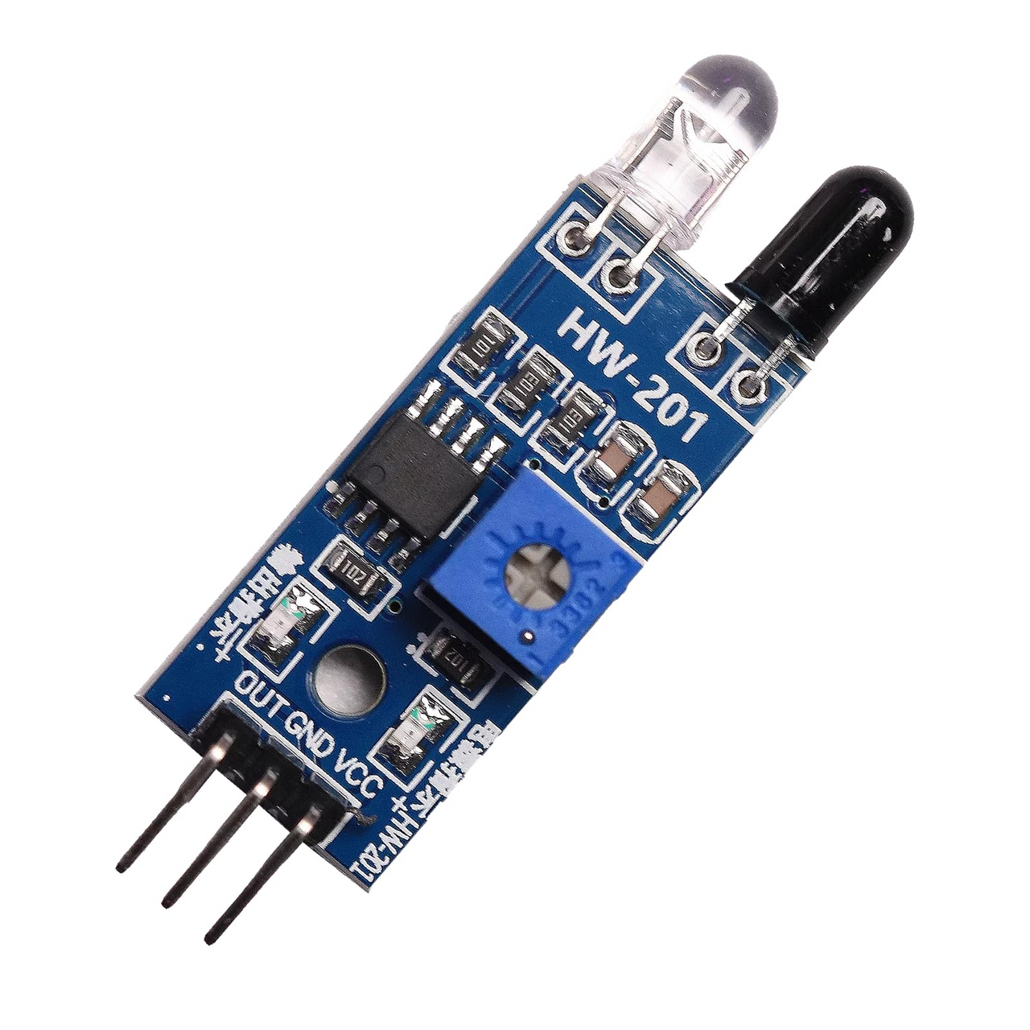


IR Sensor HW-201

Slide 11
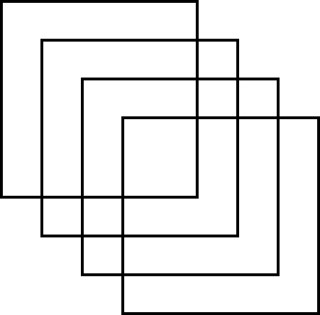
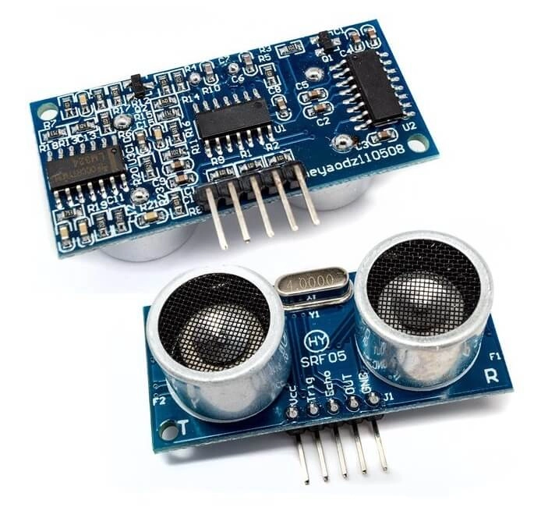

HC-SRF05

Slide 12
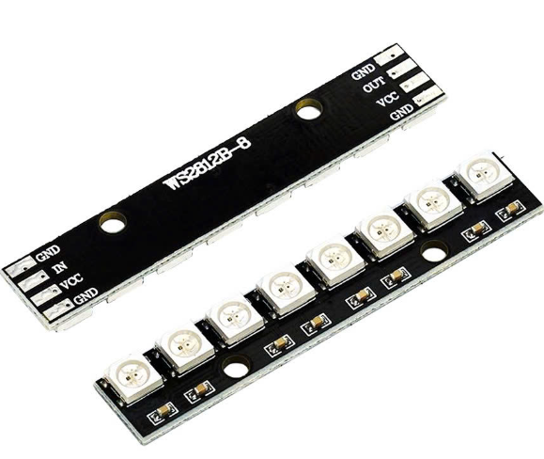
Led RGB WS2812B

Slide 13

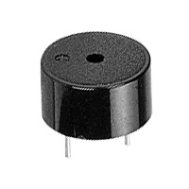

Piezo Buzzer

Slide 14
Block Diagram Overview

Slide 15
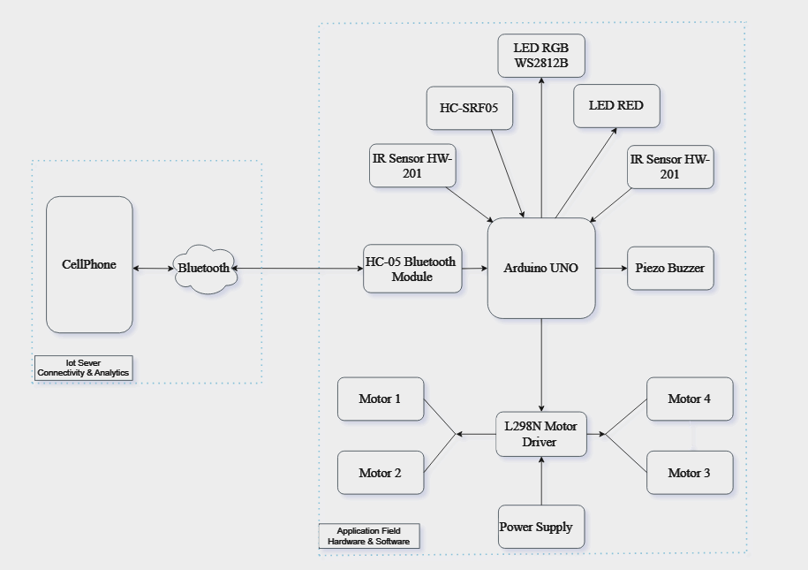


BLOCK-DIAGRAM

Slide 16

Functional analysis of components

Slide 17
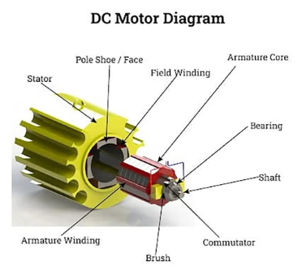
DC Motor
Structure
Stator: Permanent magnets or field windings.
Rotor (Armature): Wound coils and commutator.
Brushes: Deliver current to the rotor.
Shaft: Transfers rotational motion.
Bearings: Reduce friction.
Features
Voltage: Commonly 5V, 12V, or 24V.
Speed: Proportional to the supply voltage.
Torque: Inversely proportional to speed.
Starting Current: Higher than the nominal current.
Control: Via voltage adjustment or PWM.

Slide 18
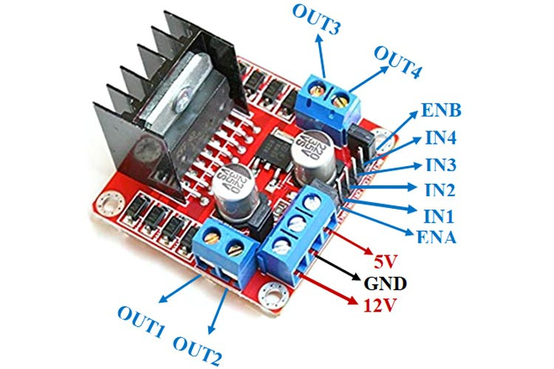
L298N Motor Driver
Structure:
L298N IC: Dual H-Bridge, supports 2 channels, max current 2A/channel, max motor voltage 46V.
Connectors:
VCC, GND, 5V: Power inputs.
IN1, IN2, IN3, IN4: Control motor direction.
ENA, ENB: Enable speed control via PWM.
OUT1, OUT2, OUT3, OUT4: Motor outputs.
Heatsink: Metal heatsink for high current operations.
Flyback Diodes: Protect against back EMF.
Features:
Motor voltage: 5V - 35V, logic voltage: 5V.
Max current: 2A/channel.
Speed control: PWM signal on ENA/ENB.
Direction control: Logic on IN1-IN4.
Integrated jumper for logic power.
:

Slide 19
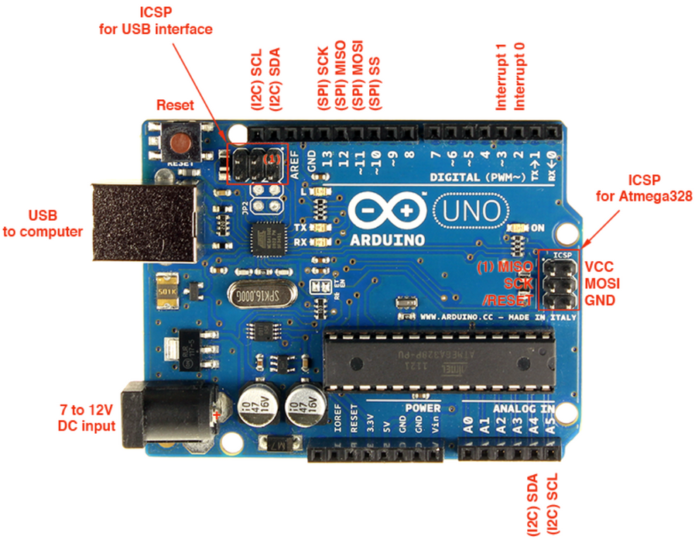
Arduino UNO
Structure
Microcontroller: ATmega328P.
Pins:
14 Digital I/O (6 PWM).
6 Analog Inputs.
Power:
Vin: 7-12V.
5V, 3.3V: Regulated outputs.
GND: Ground.
USB Port: Power and programming.
ICSP Header: For programming.
Reset Button: Microcontroller reset.
Features
Voltage: 5V logic, 7-12V input.
Memory: 32 KB Flash, 2 KB SRAM, 1 KB EEPROM.
Communication: Serial (UART), SPI, I2C.
Programming: Arduino IDE.

Slide 20
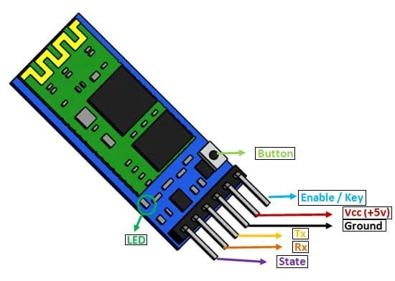
HC-05 Bluetooth Module
Structure
Microcontroller: Handles Bluetooth communication.
Antenna: Built-in for wireless signal transmission.
Pins:
GND: Ground pin.
KEY/Enable: Puts the module into command mode for configuration.
TX: Transmits data to other devices.
RX: Receives data from other devices.
Status LED: Indicates the module's state.
Features
Bluetooth Version: 2.0+EDR.
Range: Up to 10 meters.
Baud Rate: Default 9600 bps, configurable.
Modes: Command mode (configuration), Data mode (communication).
Power Supply: 3.3V (supports 5V input).
Interface: UART

Slide 21
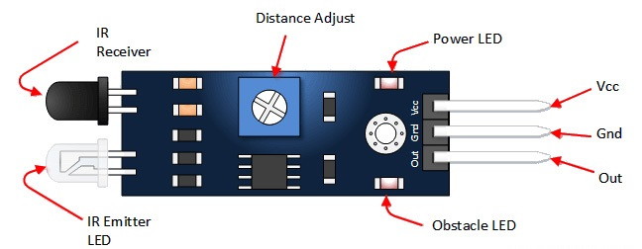
IR Sensor HW-201
Structure
IR Emitter LED: Emits infrared light.
IR Receiver (Photodiode): Detects reflected IR signals.
Distance Adjust (Potentiometer): Sets detection range.
Power LED: Indicates the module is powered.
Obstacle LED: Lights up when an obstacle is detected.
Pins:
VCC: Power supply (3.3V - 5V).
GND: Ground pin.
OUT: Digital output signal.
Characteristics:
Voltage: 3.3V - 5V.
Range: Adjustable (2-30 cm).
Output: Digital (HIGH/LOW based on obstacle presence).

Slide 22
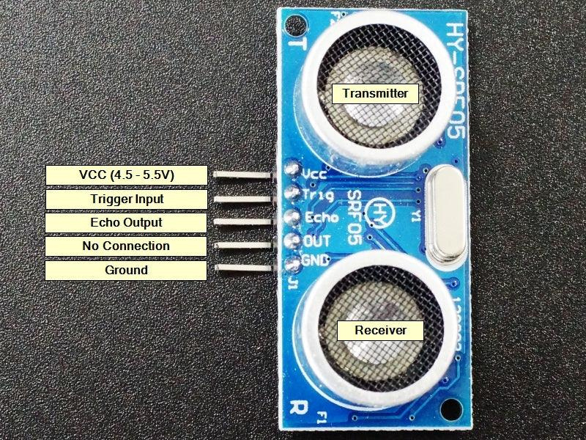
HC-SRF05
Structure
Transmitter: Emits 40 kHz ultrasonic waves.
Receiver: Receives the reflected signal (echo).
Pins:
VCC: Provides 5V power supply.
GND: Ground pin.
Trig: Trigger pin to emit ultrasonic waves.
Echo: Receives the reflected signal, with pulse width proportional to distance.
No Connection (OUT): Not used (no connection).
Features
Operating Voltage: 5V.
Measuring Range: 2 cm - 400 cm.
Accuracy: ±3 mm.
Operating Frequency: 40 kHz.
Distance Calculation: Distance = (Pulse time × 0.034) / 2.

Slide 23
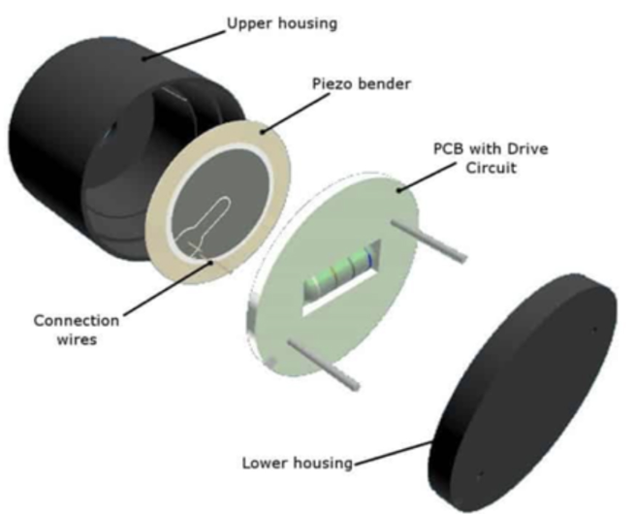
Piezo Buzzer
Structure:
Piezoelectric Disc: The component that generates sound when subjected to electrical signals.
Piezo Bender: A bending structure that enhances sound generation.
Upper Housing and Lower Housing: Protect the internal components.
PCB with Drive Circuit: Printed circuit board that controls the sound signal.
Connection Wires: Provide electrical connections to the buzzer.
Features
Operating Voltage: 3V - 12V.
Sound Frequency: Typically 2 kHz - 4 kHz.
Current Consumption: Low, energy-efficient.
Sound Output: Emits sound when electrical signals are applied.
Size: Compact, suitable for integration into electronic devices.

Slide 24
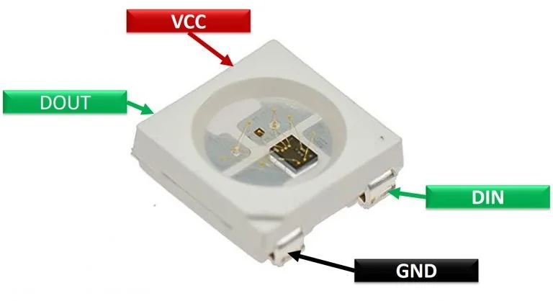
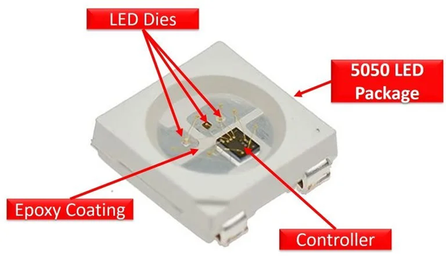
Led RGB WS2812B
Structure
RGB LED: Three integrated LEDs (Red, Green, Blue).
Control Chip: Integrated IC for controlling color and brightness.
Pins:
VCC: Provides 5V power.
GND: Ground pin.
DIN: Data input.
DOUT: Data output.
Features
Operating Voltage: 5V.
Color: Supports millions of colors.
Control: Digital data signal (PWM).
Feature: Each LED can be controlled independently.
Easy to Chain: Multiple LEDs can be connected in series.
Epoxy Coating: Protects the LED from moisture, dust, and mechanical damage, enhancing durability and lifespan.
5050 LED Package: Larger package (5.0mm x 5.0mm) with three LEDs (Red, Green, Blue) per package, providing higher brightness than smaller packages.

Slide 25



Circuit details

Slide 26
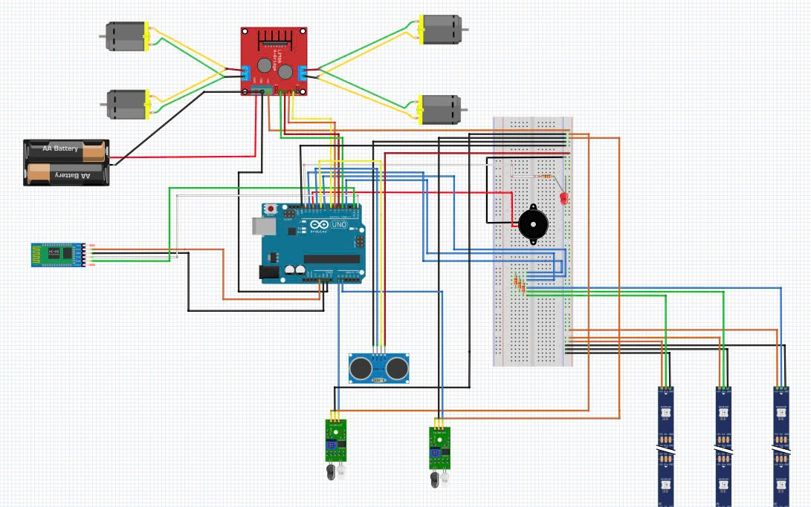
Detailed Diagram

Slide 27
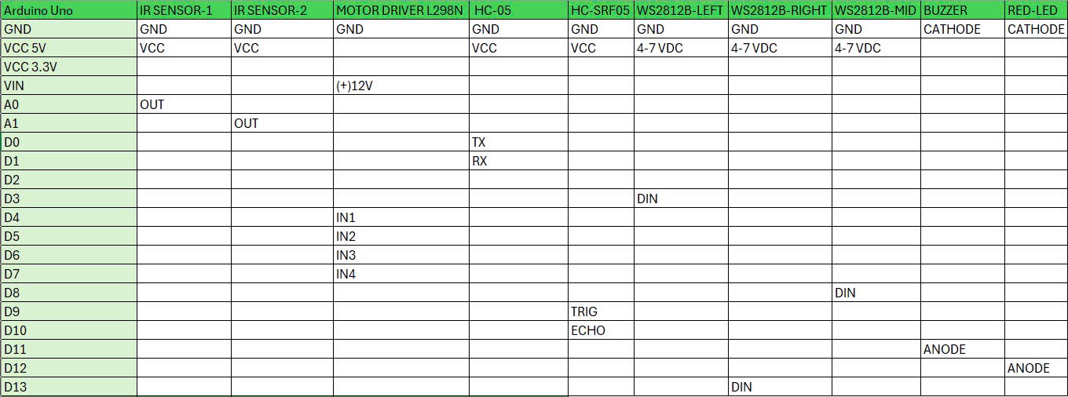


Slide 28
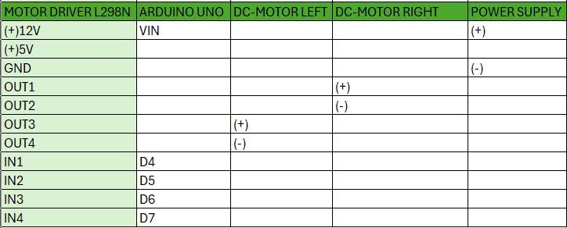

Slide 29
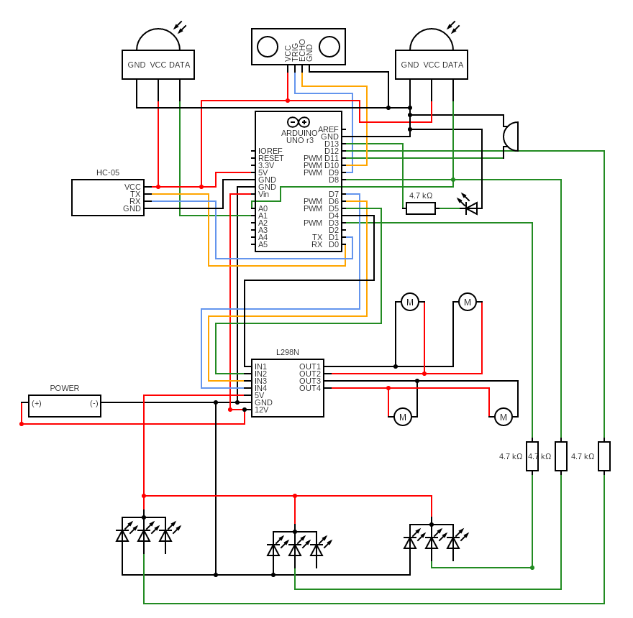
Circuit DIAGRAM

Slide 30
Device images and functionality

Slide 31
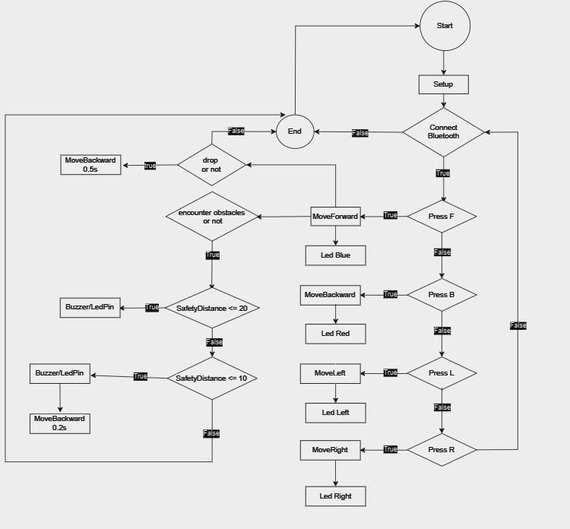
Flowchart

Slide 32
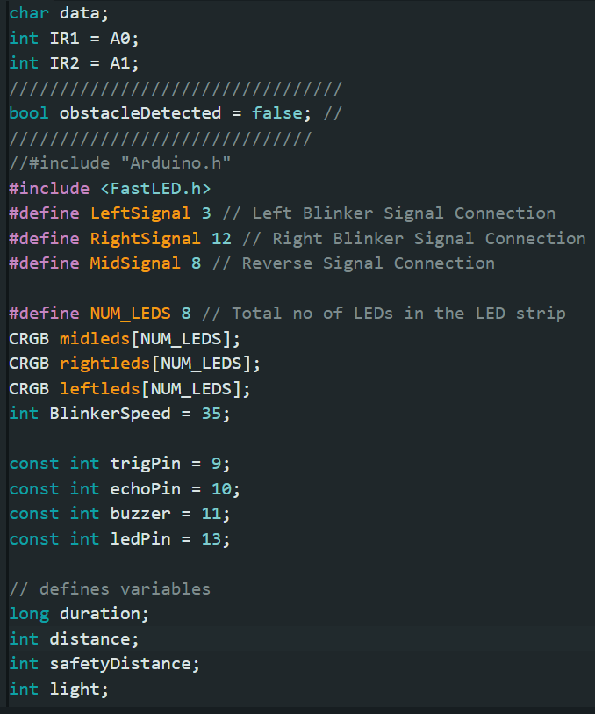

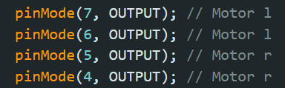
declare pins

Slide 33
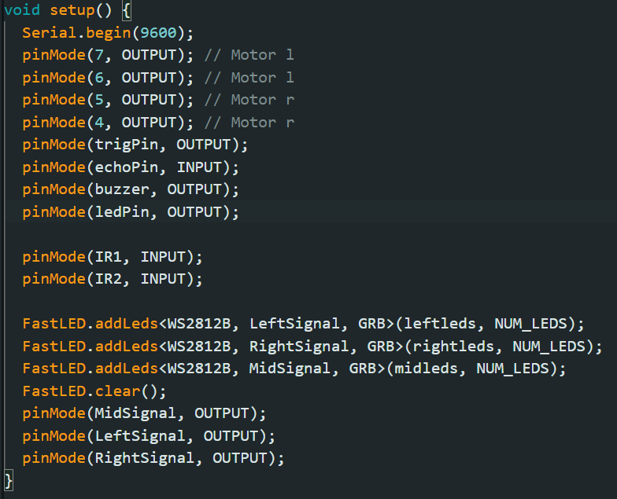
setup

Slide 34
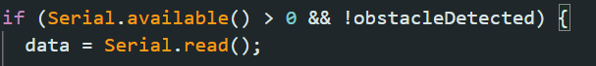
Read Data

Slide 35
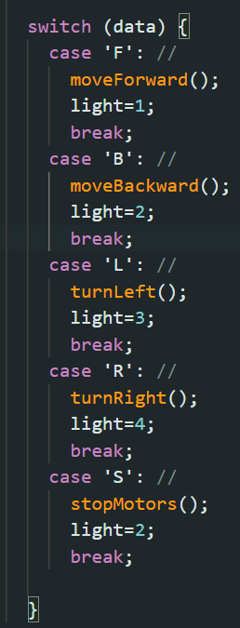
Car Control

Slide 36
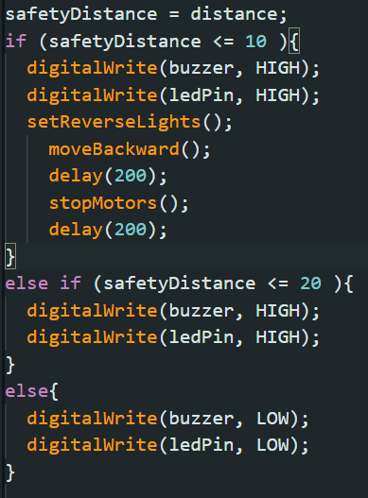
Detect Obstacles Ahead

Slide 37
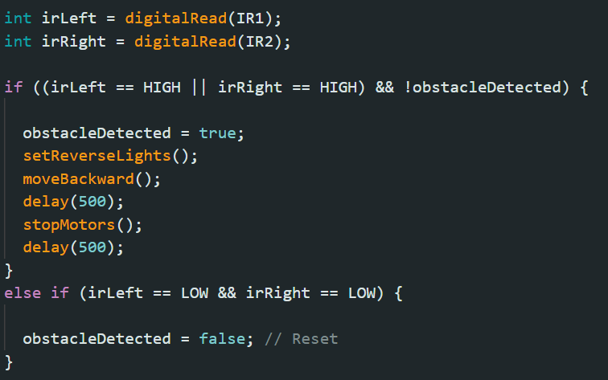
Detect Deep Hole Ahead

Slide 38
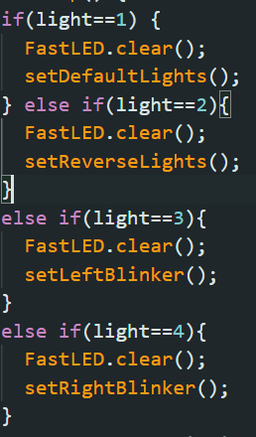
LED Blue
LED Red
LED Turn Left
LED Turn Right

Slide 39
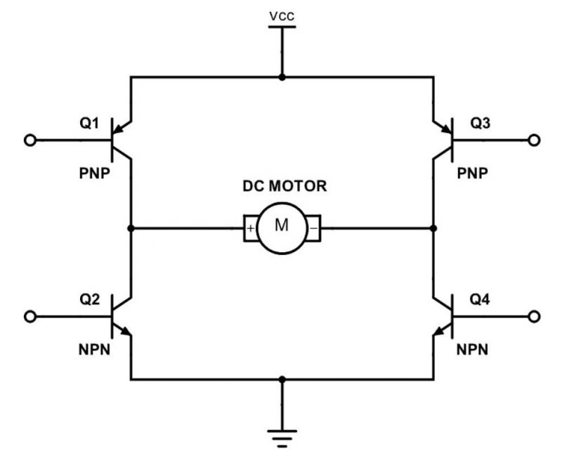

Slide 40
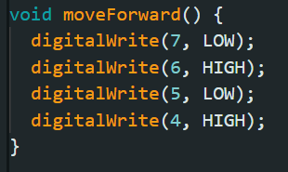
Move Forward

Slide 41
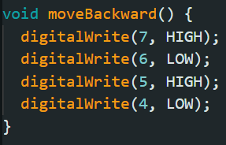
Move Backward

Slide 42
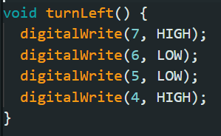
Turn Left

Slide 43
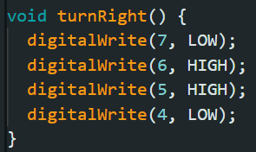
Turn Right

Slide 44
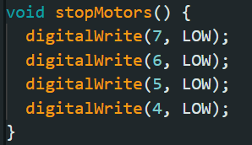
Stop Motors

Slide 45
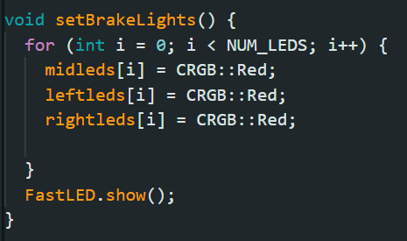
Brake Lights

Slide 46
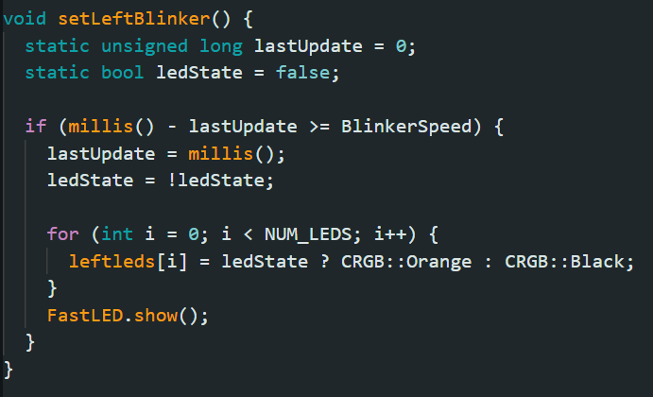
Left Blinker

Slide 47
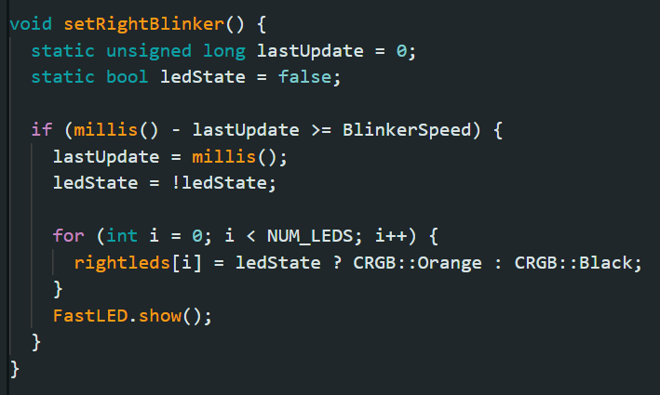
Right Blinker

Slide 48
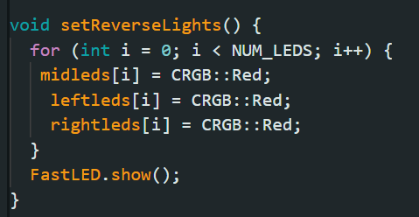
Reverse Lights

Slide 49
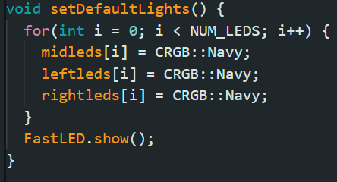
Default Lights

Slide 50
Demo Project and Control App Introduction

Slide 51

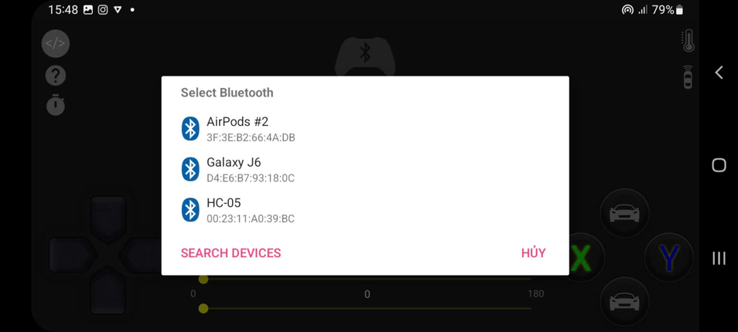
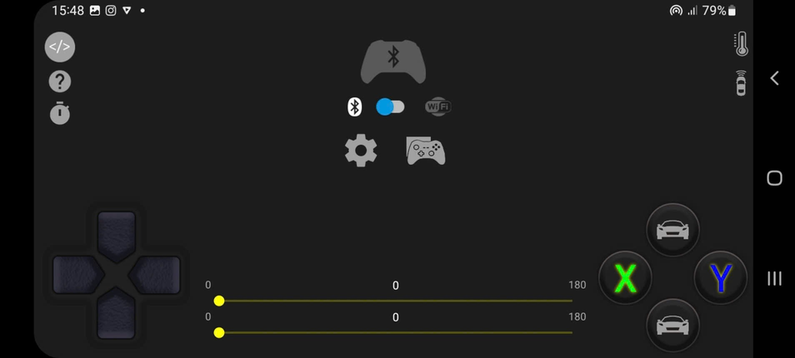
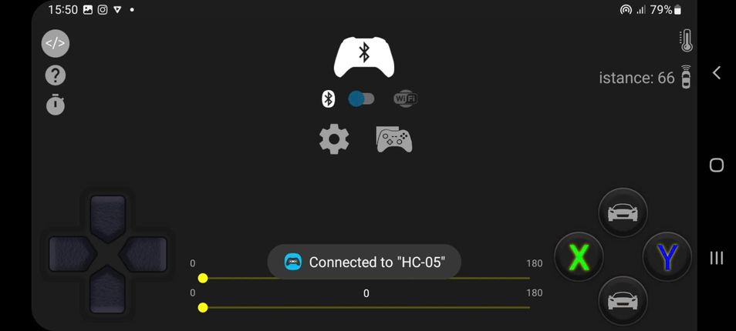
APP INSTALLATION GUIDE
Step 1:
Step 3:
Step 2:
Step 4:

Slide 52

DEMO PROJECT

Slide 53
Practical applications and future plans

Slide 54


REAL-WORLD APPLICATIONS
This remote-controlled robot car combines essential safety and control features with practical real-world applications. Its versatility makes it a valuable tool for education, industry, agriculture, and even household assistance. Its modular design allows easy customization to meet specific requirements, opening the door to endless possibilities.

Slide 55



Applications in INDUSTRIAL AUTOMATION

Slide 56



FUTURE DEVELOPMENT DIRECTIONS
Enhancing Automation
Traffic safety
Education
Economy
Entertainment

Slide 57
Disadvantages
Power Efficiency
Sensor Range
Chassis Stability
Durability

Slide 58
Conclusion
This project successfully developed a prototype autonomous RC car featuring obstacle detection, anti-fall mechanisms, and Bluetooth control. It demonstrates the practicality of integrating IoT technologies into real-world applications while contributing to affordable, adaptable solutions for robotics and IoT research and education.

Slide 59
References
“Bluetooth-controlled car with hc-05 module — arduino project hub,” [Online; accessed 2024-12-12]. [Online]. Available: https://projecthub.arduino.cc/angadiameya007/bluetooth-controlled-car-with-hc-05-module-e90493
“Cach dung module dieu kien dong co l298n - cau h de dieu khien dong co dc — cong dong arduino viet nam,” 6 2016, [Online;accessed 2024-12-12]. [Online]. Available: http://arduino.vn/bai-viet/893-cach-dung-module-dieu-khien-dong-co-l298n-cau-h-de-dieu-khien-dong-co-dc
“(88) how to make diy arduino table edge avoidance robot - youtube,” [Online; accessed 2024-12-12]. [Online]. Available:https://www.youtube.com/watch?v=Tw9qCqcAsP4
“Su dung cam bien khoang cach hc-sr04 — cong dong arduino viet nam,” 7 2014, [Online; accessed 2024-12-12]. [Online].Available: http://arduino.vn/bai-viet/233-su-dung-cam-bien-khoang-cach-hc-sr04

Slide 60


Slide 61



THANK YOU FOR WATCHING

